Slide 1


New Tab
New Tab
New Tab
New Tab
Google
Aysha and mysterious machines

Slide 2




Aysha and mysterio
New Tab
New Tab
New Tab
google.com/search?q=Aysha+and+Mysterious+Machines&rlz=1C1CHBD_en-GBPK1021PK1021&oq
Google
Aysha and Mysterious Machines
Bio of Aysha
She is 10 years old and a detective by profession, assigned to answer the questions that will change her life. Are you ready to help her in finding the answers???
Questions to Answers
What Aysha can do?
What mama/ cats/ heroes can do?
What machines can do?
Clues for Aysha!!! Yayyyy!!!!
Focus on what you did till now, like slept, woke up, brush your teeth (I can’t tell more you have to find by yourself), what mama did?, did you use any machine today?
Bonus level: Who is smarter machines or Aysha?
This is a bonus question to reach to level 5.

Slide 3
Aysha and mysterio
New Tab
New Tab
New Tab
google.com/search?q=Aysha+and+Mysterious+Machines&rlz=1C1CHBD_en-GBPK1021PK1021&oq
Google
Aysha and Mysterious Machines
Bio of Aysha
She is 10 years old and a detective by profession, assigned to answer the questions that will change her life. Are you ready to help her in finding the answers???
Questions to Answers
What Aysha can do?
What mama/ cats/ heroes can do?
What machines can do?
Clues for Aysha!!! Yayyyy!!!!
Focus on what you did till now, like slept, woke up, brush your teeth (I can’t tell more you have to find by yourself), what mama did?, did you use any machine today?
Bonus level: Who is smarter machines or Aysha?
This is a bonus question to reach to level 5.

Slide 4
Aysha and mysterio
New Tab
New Tab
New Tab
google.com/search?q=Aysha+and+Mysterious+Machines&rlz=1C1CHBD_en-GBPK1021PK1021&oq
Google
Aysha and Mysterious Machines
Bio of Aysha
She is 10 years old and a detective by profession, assigned to answer the questions that will change her life. Are you ready to help her in finding the answers???
Questions to Answers
What Aysha can do?
What mama/ cats/ heroes can do?
What machines can do?
Clues for Aysha!!! Yayyyy!!!!
Focus on what you did till now, like slept, woke up, brush your teeth (I can’t tell more you have to find by yourself), what mama did?, did you use any machine today?
Bonus level: Who is smarter machines or Aysha?
This is a bonus question to reach to level 5.

Slide 5
Aysha and mysterio
New Tab
New Tab
New Tab
google.com/search?q=Aysha+and+Mysterious+Machines&rlz=1C1CHBD_en-GBPK1021PK1021&oq
Google
Aysha and Mysterious Machines
Bio of Aysha
She is 10 years old and a detective by profession, assigned to answer the questions that will change her life. Are you ready to help her in finding the answers???
Questions to Answers
What Aysha can do?
What mama/ cats/ heroes can do?
What machines can do?
Clues for Aysha!!! Yayyyy!!!!
Focus on what you did till now, like slept, woke up, brush your teeth (I can’t tell more you have to find by yourself), what mama did?, did you use any machine today?
Bonus level: Who is smarter machines or Aysha?
This is a bonus question to reach to level 5.

Slide 6
Aysha and mysterio
Clues for Aysha
New Tab
New Tab
google.com/search?q=Clues+for+Aysha!!!+Yayyy!!!!&rlz=1C1CHBD_en-GBPK1021PK1021&oq
Clues for Aysha!!! Yayyyy!!!!
Focus on what you did till now, like slept, woke up, brush your teeth (I can’t tell more you have to find by yourself), what mama did?, did you use any machine today?
Breaking vase
Aysha broke a vase today And got scolded for it. Her day started of bad
Reading
Aysha reads a lot of novels. Her favorite is Aysha and mysterious machines
Studying
Aysha doesn’t like to study rather like to solve mysteries
Hiding
After breaking a vase and running from studying Aysha goes to hide.

Slide 7
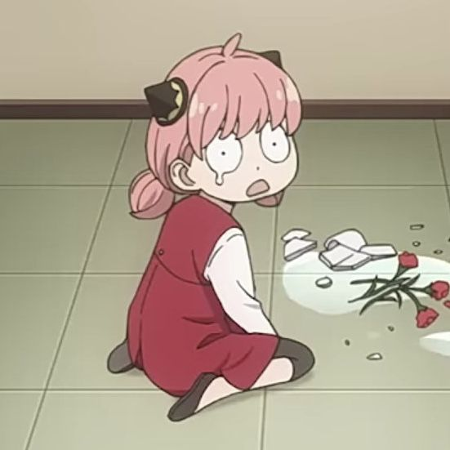

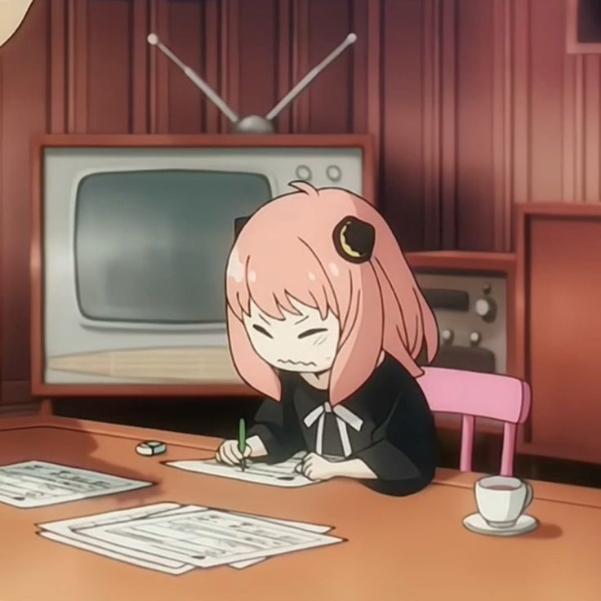
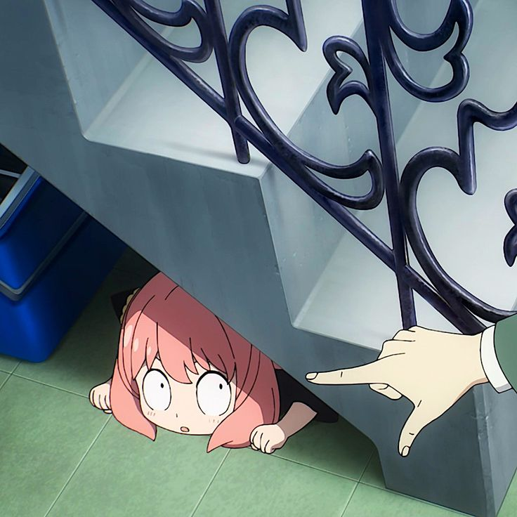
Aysha and mysterio
Clues for Aysha
New Tab
New Tab
google.com/search?q=Clues+for+Aysha!!!+Yayyy!!!!&rlz=1C1CHBD_en-GBPK1021PK1021&oq
Clues for Aysha!!! Yayyyy!!!!
Focus on what you did till now, like slept, woke up, brush your teeth (I can’t tell more you have to find by yourself), what mama did?, did you use any machine today?
Breaking vase
Aysha broke a vase today And got scolded for it. Her day started of bad
Reading
Aysha reads a lot of novels. Her favorite is Aysha and mysterious machines
Studying
Aysha doesn’t like to study rather like to solve mysteries
Hiding
After breaking a vase and running from studying Aysha goes to hide.

Slide 8




Aysha and mysterio
Clues for Aysha
What others can do?
New Tab
google.com/search?q=What+others+can+do?&rlz=1C1CHBD_en-GBPK1021PK1021&oq
Google
What others can do?
Mama
Cats
Heroes
Teachers
Mama can take care of us, She can cook delicious food, she helps in homework, she tells stories at night and many more things she is capable of.
Cats just eat and sleep
They save us from dangers.
They teach, give us homework, check our homework

Slide 9


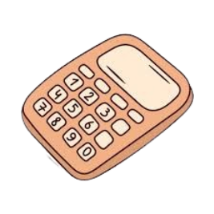

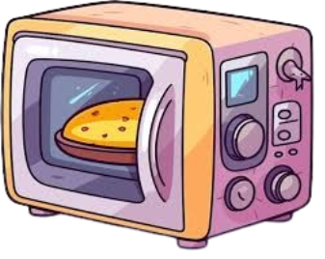
Aysha and mysterio
Clues for Aysha
What others can do?
What machines can
google.com/search?q=What+machines+can+do?&rlz=1C1CHBD_en-GBPK1021PK1021&oq
Google
What machines can do?
Washing Machine
Calculator
Wash clothes.
Perform calculations
Oven
Computer
Heat our food
Do what we ask for such as perform calculations, store our data, searching, organize our files, play games, paint and many many more things a computer can do

Slide 10
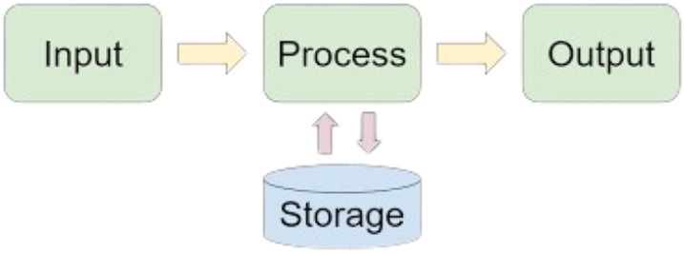
Aysha and mysterio
Clues for Aysha
What others can do?
What machines can
google.com/search?q=What+machines+can+do?&rlz=1C1CHBD_en-GBPK1021PK1021&oq
Google
What machines can do?
Computers
How computers think?
Input
Processing
output

Slide 11
Aysha and mysterio
Clues for Aysha
What others can do?
What machines can
google.com/search?q=What+machines+can+do?&rlz=1C1CHBD_en-GBPK1021PK1021&oq
Google
What machines can do?
Now Answer
Who is smarter?
Computers
How computers think?
Input
Processing
output
Human
Computer

Slide 12
Aysha and mysterio
Clues for Aysha
What others can do?
What machines can
google.com/search?q=What+machines+can+do?&rlz=1C1CHBD_en-GBPK1021PK1021&oq
Google
What machines can do?
U r leveled up!!!!
Computers
How computers think?
Input
Processing
output

